Slide 1
Fraud Detection System

Slide 2
Agenda
1. Project Overview
2. Dataset Overview & EDA
3. Feature Engineering
4. Model Building & Selection
5. Model Performance Evaluation
6. Financial Impact Analysis
Power BI Dashboard
Conclusion

Slide 3
Project Overview
Goal
Develop a robust ML model to accurately detect fraudulent mobile financial transactions in real-time
Deliverables
Production-ready fraud detection model
Comprehensive model performance and financial impact analysis
Business Impact
Improve security, reduce financial losses, and gain insights into fraud patterns
Problem Statement
Mobile transactions are growing rapidly
Fraud causes billions in losses every year
Need for ML based real-time detection

Slide 4
Dataset Overview & EDA
Dataset
11,142 transactions | 10 columns | No missing values
10,000 Legitimate vs 1,142 Fraud (Class Imbalance)
Key EDA Findings
Fraud occurs ONLY in TRANSFER and CASH_OUT transactions
Avg fraud amount 1.19M vs 101K for legitimate (12x higher)
Strong correlations between balance columns (0.93-0.94)
Visualizations Used
Correlation Heatmap, Boxplots, Countplots, Amount by Fraud, Type vs Fraud

Slide 5
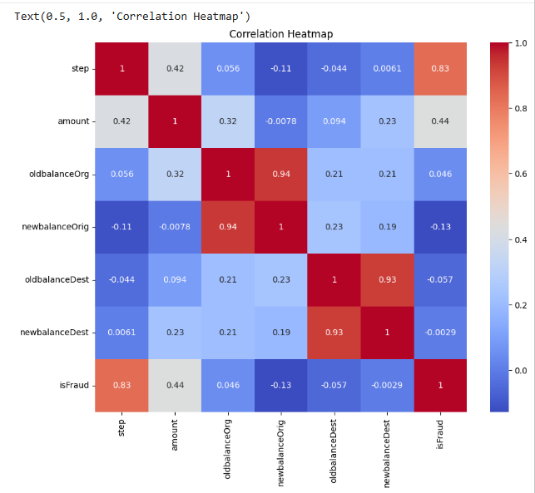
Correlation Heatmap

Slide 6
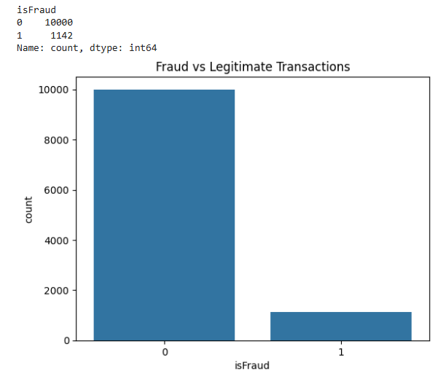
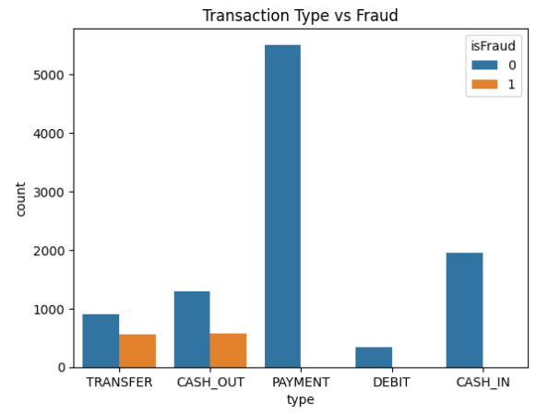
Fraud vs Legitimate Transactions - Countplot
Transaction Type vs Fraud - Countplot

Slide 7
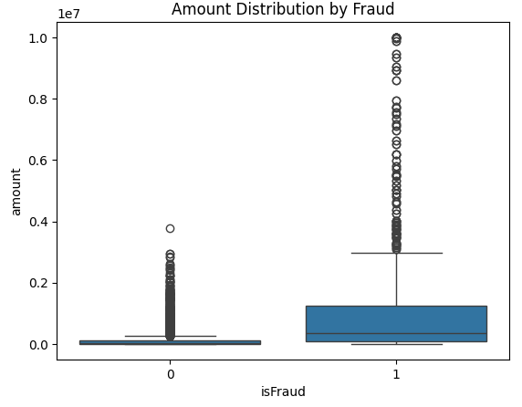
Amount Distribution by Fraud — Boxplot
X-axis
0 = Legitimate transactions
1 = Fraud transactions
Y-axis
Amount of transaction in values up to 10 million

Slide 8
Feature Engineering
New Features Created
balanceDiffOrig - How much money left the sender account
balanceDiffDest - How much money arrived in receiver account
errorBalanceOrig - Balance manipulation check at origin
errorBalanceDest - Balance manipulation check at destination
isOriginDrained - Flag if sender account drained to zero (99.2% fraud signal)
isDestPreviouslyEmpty - Flag for mule accounts (63.7% fraud signal)
Encoding
LabelEncoder applied on transaction type column (5 categories)
nameOrig and nameDest dropped - ID columns, not useful as features
Result
13 total features used for model training

Slide 9
Why These Models ?
Logistic Regression : Simple baseline for binary classification
Random Forest : Handles complex patterns, resistant to overfitting
XG Boost : Best for structured/tabular data, high performance
Decision Tree : Easy to interpret and explain

Slide 10
Model Building & Selection
Models Evaluated
Logistic Regression - with StandardScaler for feature scaling
Random Forest - GridSearchCV
Gradient Boosting (XGBoost) - GridSearchCV
Decision Tree - baseline model after SMOTE
Class Imbalance Handling - SMOTE
Dataset: 10,000 Legit vs 1,142 Fraud (heavily imbalanced)
SMOTE balanced to equal classes, All models retrained on SMOTE data for comparison
Hyperparameter Tuning
GridSearchCV with scoring = f1 used for RF, XGBoost, RF+SMOTE
F1 scoring chosen over accuracy due to class imbalance

Slide 11
Model Performance Evaluation
Metrics Used
Precision, Recall, F1-Score, ROC-AUC, Confusion Matrix
Key Observation
Tree-based models outperformed Logistic Regression consistently
SMOTE improved recall across all models by addressing class imbalance
Best Model
Random Forest + SMOTE - ROC-AUC: 1.0000, F1-Score: 0.9997

Slide 12
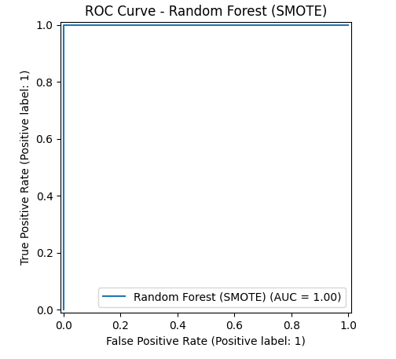
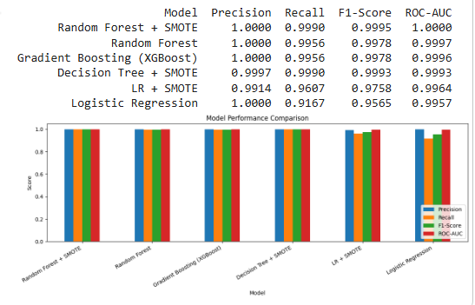
Results Summary - Model Evaluation
Best Model - ROC curve

Slide 13
Financial Impact Analysis
Model Used: Random Forest
TP (Fraud Caught): 227 out of 228
FP (False Alarms): 0
FN (Fraud Missed): 1
Financial Calculations
Average Fraud Transaction Amount: 1,192,628.93
Revenue Saved (TP x Avg Amount): 270,726,767.58
Loss from Missed Fraud (FN x Avg Amount): 1,192,628.93
Investigation Cost (FP x 500): 0.00
Net Profit: 269,534,138.65
Key Insight
Model saves approximately 270 million by catching 99.5% of all fraudulent transactions
Zero false alarms means zero unnecessary investigation costs

Slide 14
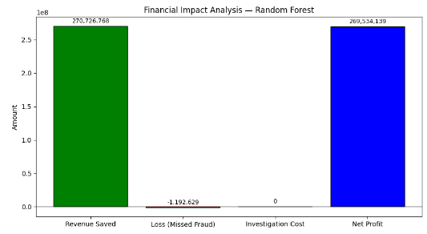
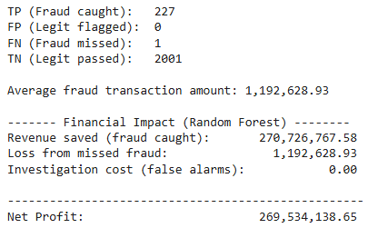
Financial Calculations
Financial Impact - Chart

Slide 15
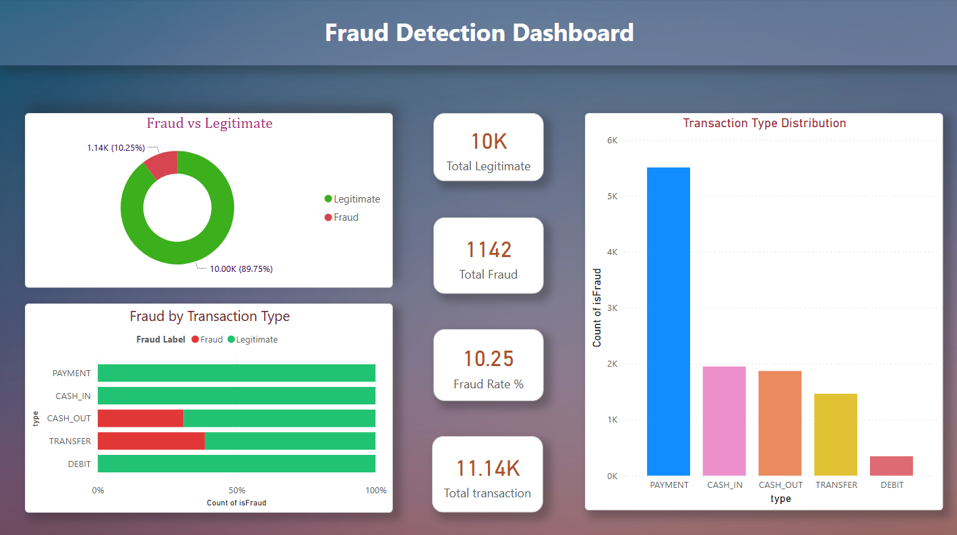
Built an interactive Power BI dashboard to visualize fraud patterns and model performance

Slide 16
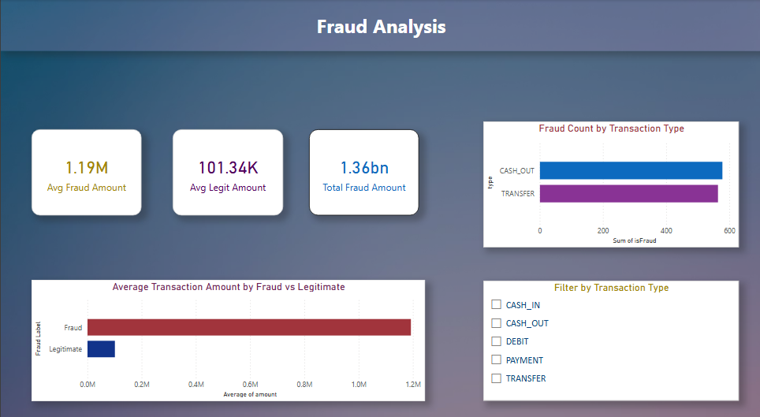

Slide 17
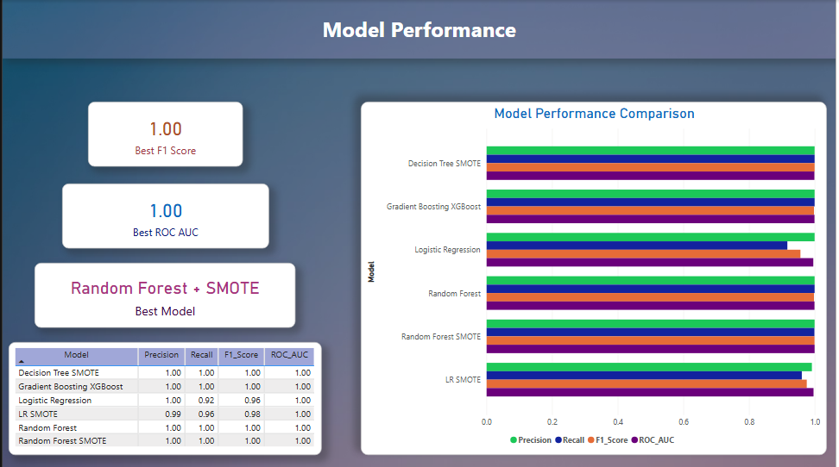

Slide 18
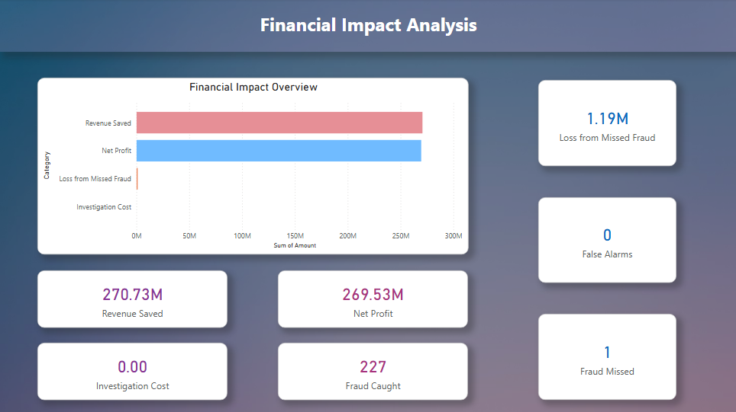

Slide 19
Conclusion
Key Findings
Fraud exclusively occurs in TRANSFER and CASH_OUT transactions
99.2% of fraud cases drain the origin account to zero
Feature engineering (isOriginDrained, errorBalanceOrig) was critical to model performance
Best Model
Random Forest + SMOTE — ROC-AUC: 1.0000, F1-Score: 0.9997
Catches 227 out of 228 fraudulent transactions with zero false alarms
Recommendation
From this analysis, I found that Random Forest + SMOTE performed best overall
This would be the most effective choice for real-world fraud detection
Due to its perfect precision, near-perfect recall and highest F1-Score

Slide 20
Business Questions:
1. What is the model's precision and accuracy in detecting fraudulent transactions?
Random Forest + SMOTE achieved perfect Precision of 1.00
Overall accuracy of 100% on test data
Every flagged transaction was genuinely fraudulent with zero false alarms
2. How reliable is the model in classifying transactions as legitimate or fraudulent?
ROC-AUC score of 1.0000 confirms near-perfect reliability
F1-Score of 0.9997 — best among all 6 models evaluated
Correctly identified 227 out of 228 fraud cases in test set
3. What are the potential losses due to model errors?
Only 1 fraud case missed — loss of ₹11.92 Lakhs
Zero false positives — no unnecessary investigation costs
Loss is only 0.44% of ₹27.07 Crore revenue saved

Slide 21
Questions ?

Slide 22
Thank You!

